Slide 1
NextHikes IT Solutions
Nazia Akhter
(Project -4)

Slide 2
LIBRARIES USED
Pandas – Data Loading, Cleaning, and manipulation.
NumPy – Numerical computations and array operations, Mathematical operations.
Matplotlib – Basic Data visualization, plotting, line charts, bar graphs and scatter plots.
Seaborn – Advanced statistical visualization with better aesthetics, heat maps, pair plots and distribution plots.
Linear models- (Scikit – learn) – Machine learning algorithms and Linear regression.

Slide 3
DATASET OVERVIEW
The Dataset contains information about mobile phone specifications and prices.
It includes various features such as RAM, Battery Capacity, Camera Quality and Price.
The Dataset is used to Analyze relationships between mobile features and price.
Data preprocessing techniques were applied to clean and prepare the dataset for analysis.
The dataset helps in performing exploratory Data Analysis (EDA) and predictive modeling.
Total Records (Rows) – 541 and Total (columns) - 12

Slide 4
DATA PREPROCESSING
Data preprocessing is the process of cleaning and preparing the dataset before analysis.
Checked the dataset for missing values and duplicate records.
Unnecessary columns and errors were removed from the dataset.
Column names were cleaned and formatted properly.
The dataset was prepared for visualization and further analysis.

Slide 5
EXPLORATORY DATA ANALYSIS
Types of Analysis Performed:-
Univariate Analysis = Analysis of a single variable (Eg-Battery Distribution)
Bivariate Analysis = Relationship between two variables (Eg- Price vs RAM)
Multivariate Analysis = Relationship among multiple variables (Eg- Correlation Heatmap).

Slide 6
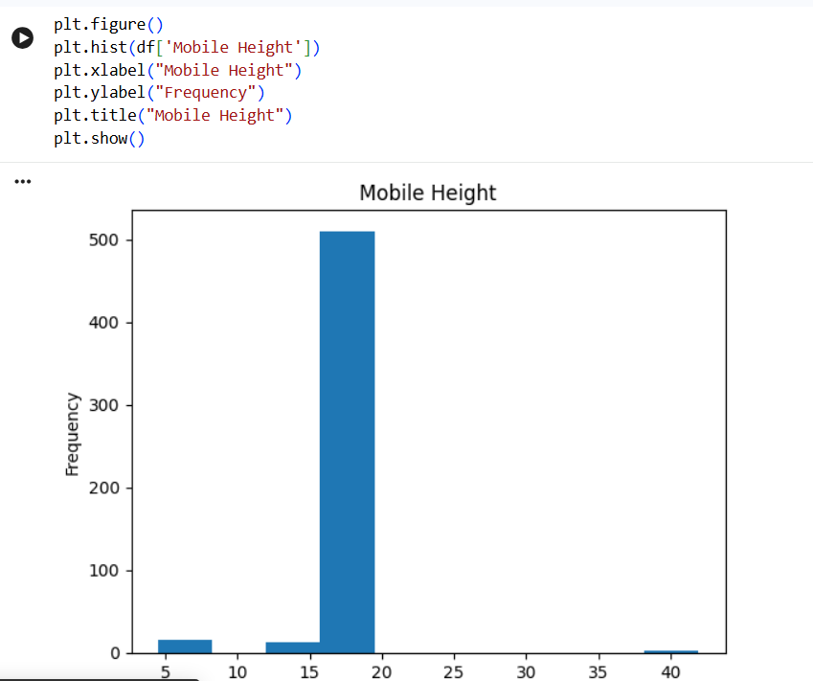
UNIVARIATE ANALYSIS
Distribution of mobile Phone height shows in the dataset.

Slide 7
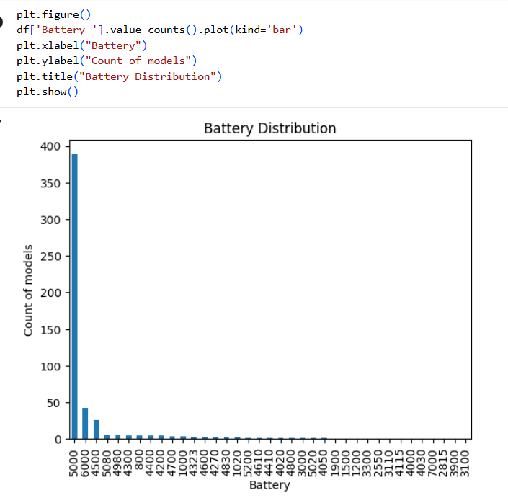
UNIVARIATE ANALYSIS
Distribution of Battery capacity among different mobile phones.
X- axis represents the battery capacity (in mAH)
Y-axis represents the number of mobile models for each battery category.

Slide 8
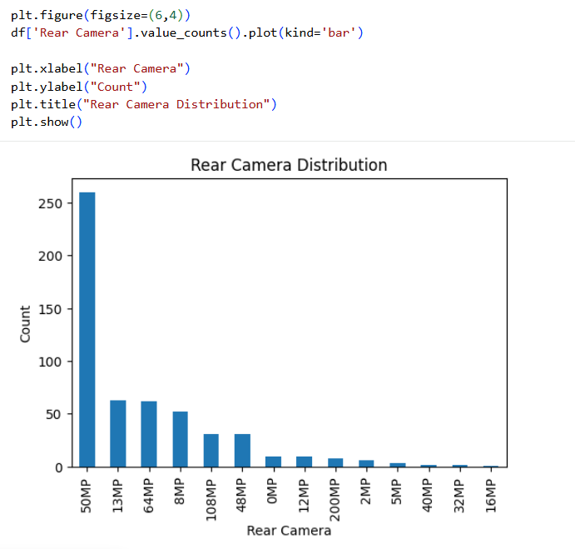
UNIVARIATE ANALYSIS

Slide 9
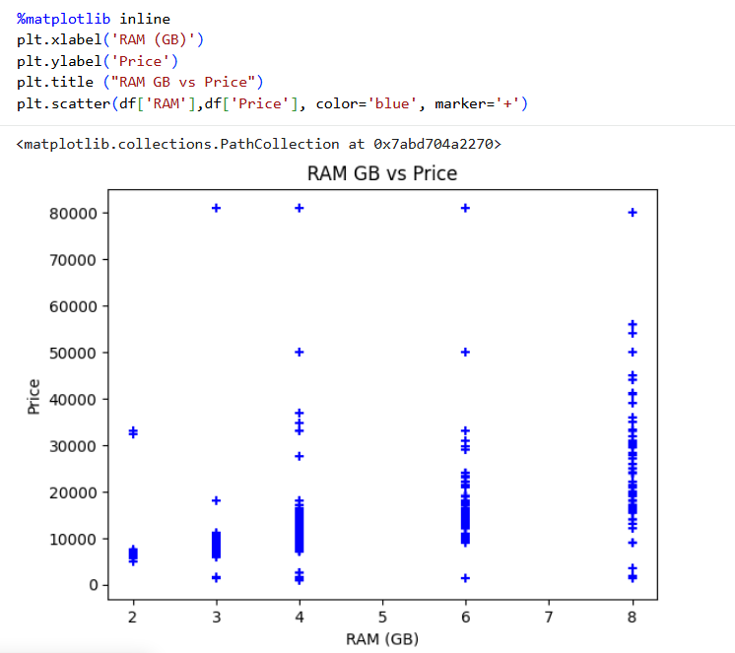
BIVARIATE ANALYSIS
Relationship between RAM capacity and the price of mobile phones.

Slide 10
BIVARIATE ANALYSIS Battery vs Price

Slide 11
BIVARIATE ANALYSIS Rear Camera Resolution vs Price

Slide 12
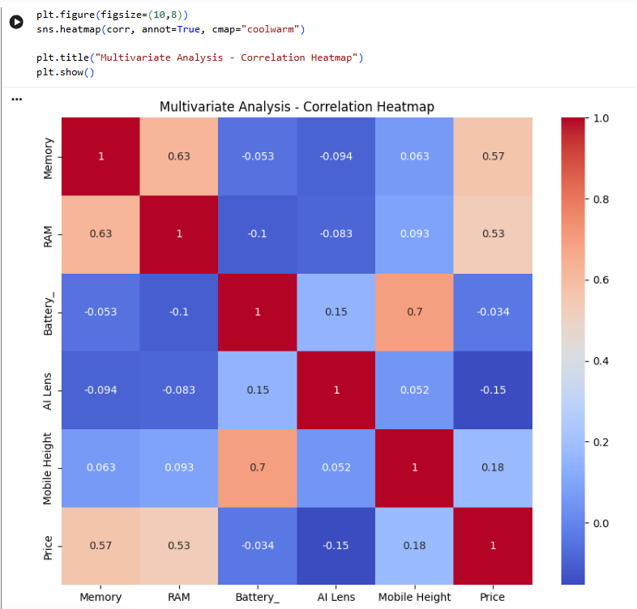
MULTIVARIATE ANALYSIS Correlation Heatmap
Correlation Analysis of Mobile Features
The heatmap shows correlation between numeric features such as RAM, Battery, Rear Camera and Price.

Slide 13
MULTIVARIATE ANALYSIS Pairplot of Mobile Features
A Pairplot shows the relationship between multiple variables at the same time.
It displays:
Scatter plots between every pair of variables
Distribution plots on the diagonal
Example relationships:
Price vs RAM
Price vs Battery
Price vs Rear Camera
RAM vs Battery

Slide 14
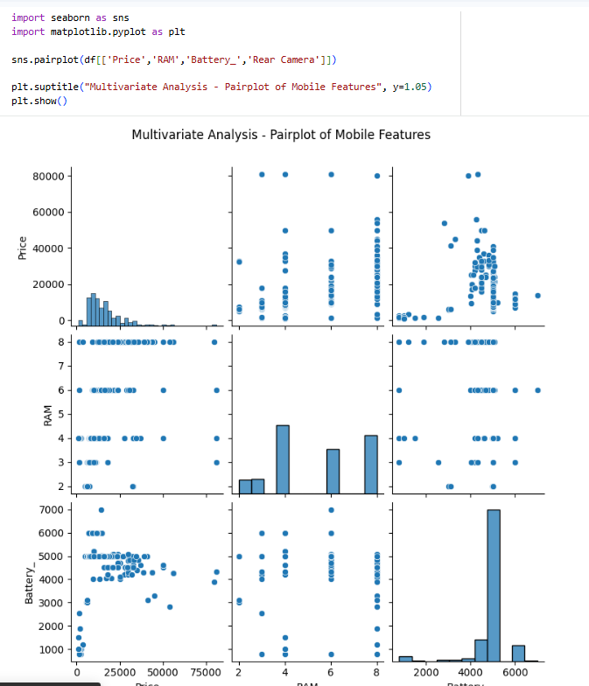
PAIRPLOT

Slide 15
THANK YOU

